Slide 1
Lehigh University IPD
Introduction to Spine Anatomy, Pathology, Anterior lumbar surgical procedure, ActivL,
Victor Nunez, Greg Nelson
Tek Park 2/10/16

Slide 2
Introduction to Spine Anatomy
With an overview of Biomechanics

Slide 3
The spine is:
7 Cervical, 12 Thoracic, 5 Lumbar vertebrae, Sacrum and Coccyx
23 discs
Annulus Fibrousus
Nucleus Pulposus
Nervous System
Cord
Cauda Equina
Peripheral Nerves
Blood Vessels
Vertebral Artery
Aorta
Vena Ceva
Muscles
Ligaments

Slide 4
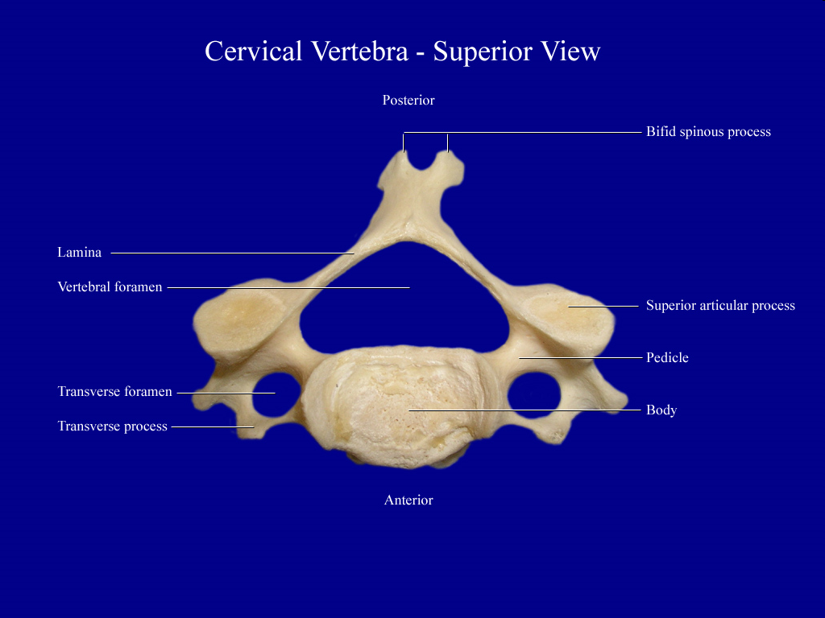
Cervical Vertebrae

Slide 5
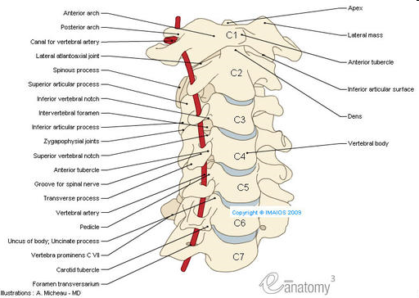
Cervical Spine

Slide 6
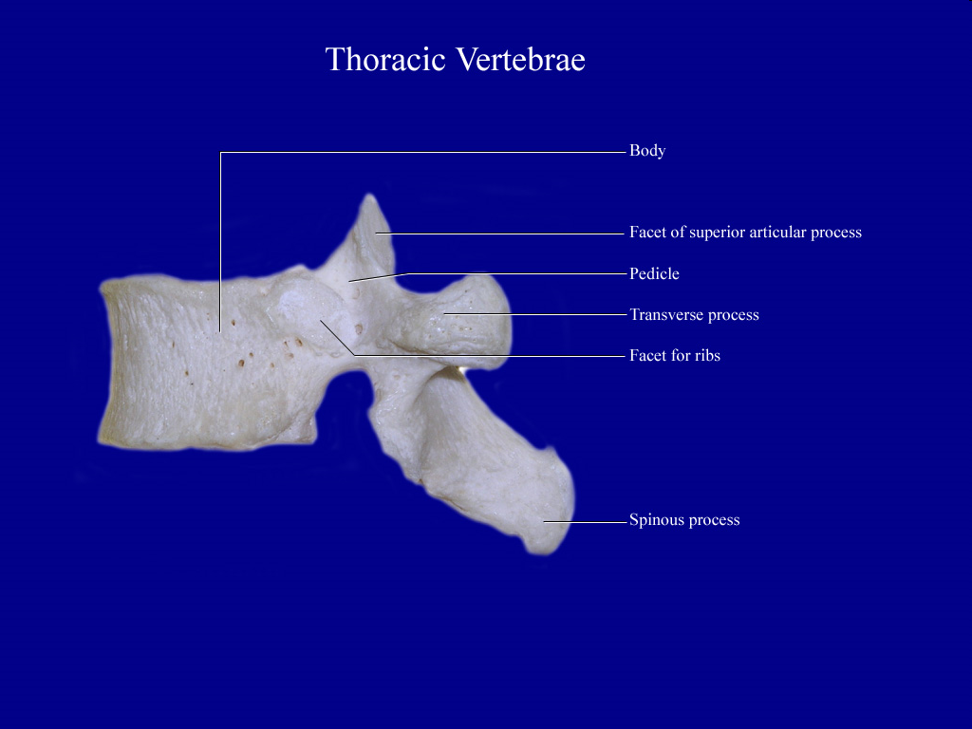
Thoracic Vertebrae

Slide 7
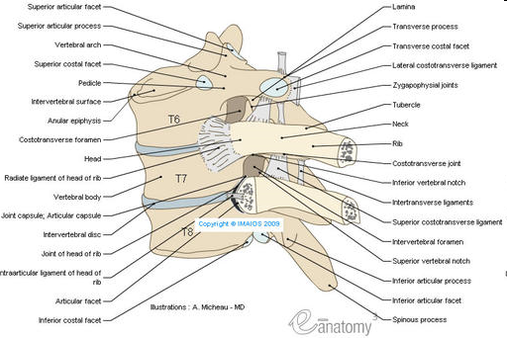
Thoracic Spine

Slide 8
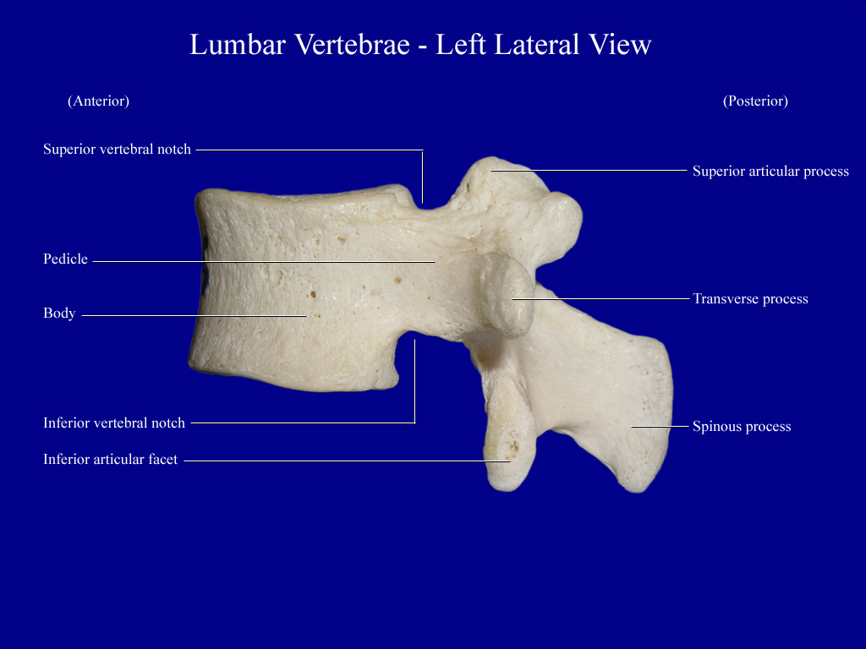
Lumbar Vertebrae

Slide 9
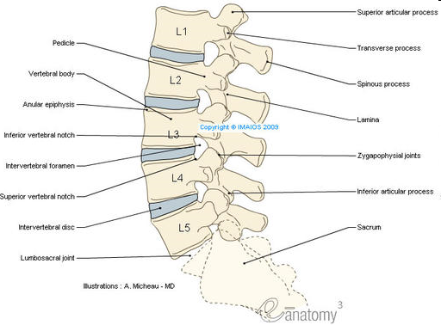
Lumbar Spine

Slide 10
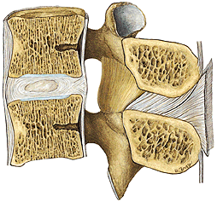
Ligaments
L. longitudinale anterior
starting at the occiput down to the sacrum
L. longitudinale
posterior
starting at the occiput down to the sacrum
Discus
intervertebralis
L. flavum
L. interspinale
L. supraspinale
starting at the occiput down to the sacrum
Notes:
10

Slide 11
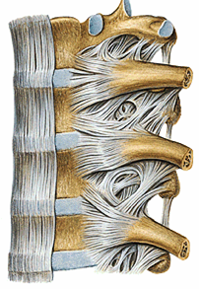
Ligaments
Fovea costalis
Discus
intervertebralis
L. longitudinale anterior
L. capiti costae
radiatum
L. costotransversia
11
Notes:
11

Slide 12
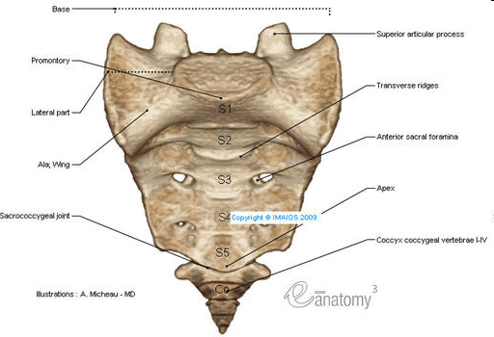
Sacrum and Coccyx

Slide 13
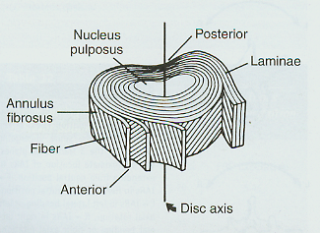
Disc
Annulus
Concentric collagen sheets
Fibers offset 30° and 45° angles, bi-directional
Nucleus
90% water, proteoglycans
Positioned slightly posterior of center

Slide 14
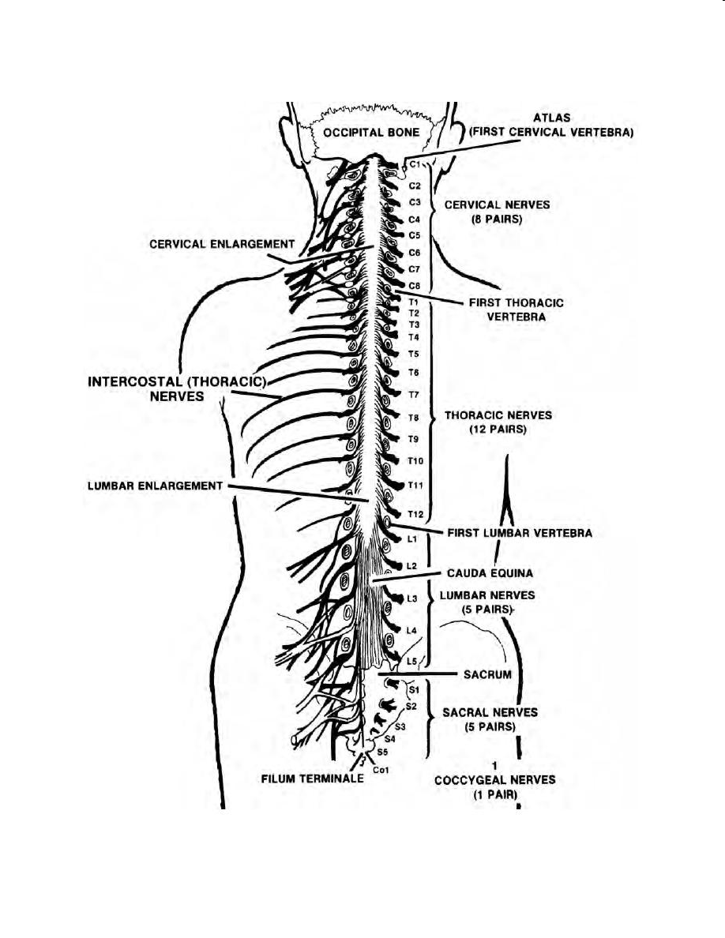
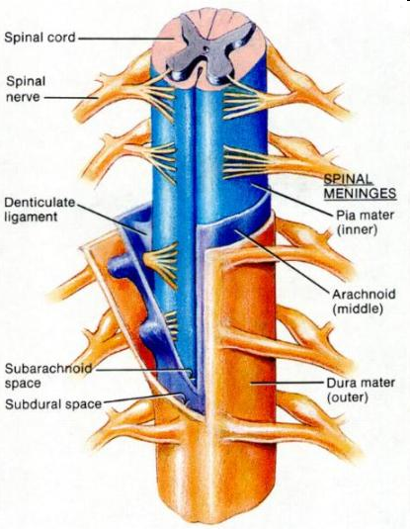
Nervous System

Slide 15
Introduction to Lumbar Pathology
What goes wrong…

Slide 16
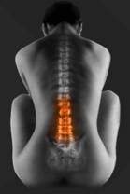
Back Pain- Causes
Disc Degeneration
Trauma
Tumor
Congenital (Deformity)
Infection
Psychogenic factors
Non-Orthopeadic pathology

Slide 17
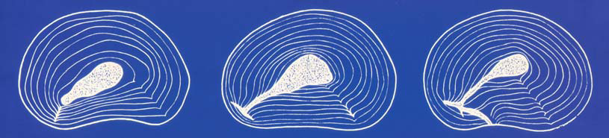
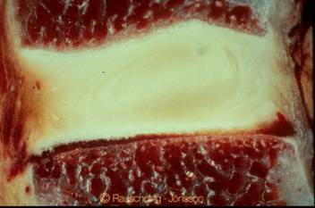
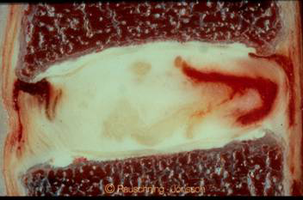
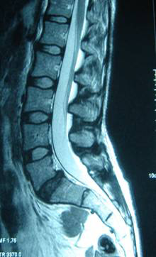
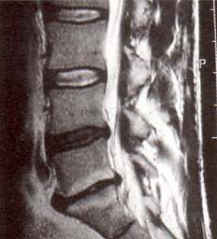
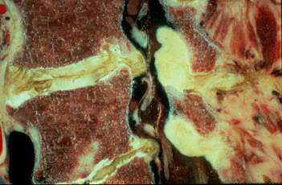
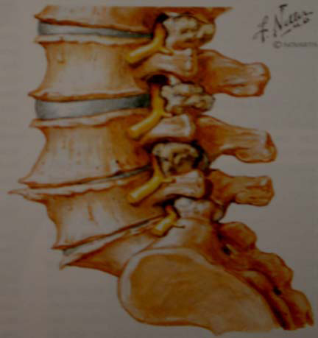
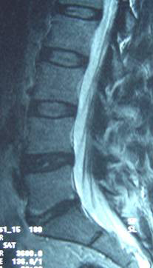
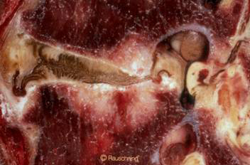
Disc Degeneration
Degeneration of structural integrity of intervertebral disc
Tears in annulus
Dislocation of nucleus pulposus
loss of water content
reduction of disc height
inability to withstand mechanical forces (shear, compression, rotation)

Slide 18
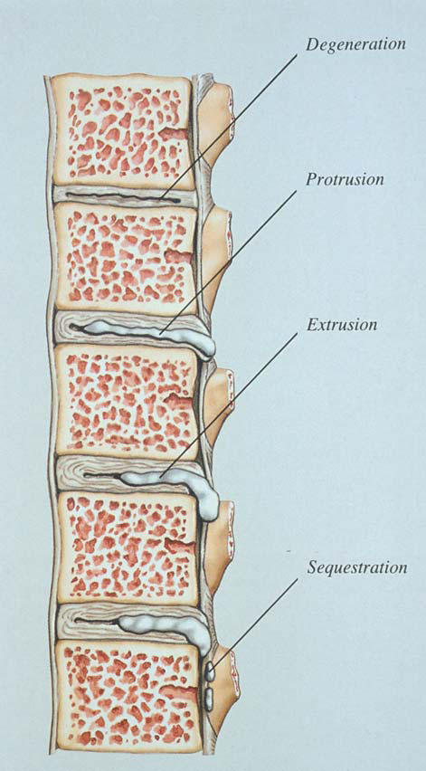
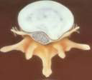
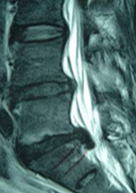
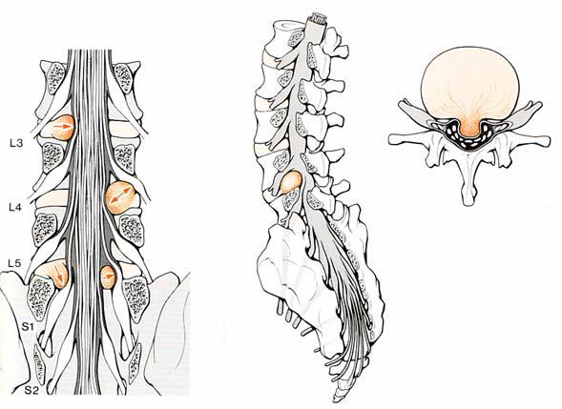
Lumbar Disc Herniation
Herniation of nucleus pulposus through the annulus fibrosus and compression of the neural structures (Spinal Cord/Caudal Equina/nerve root)

Slide 19
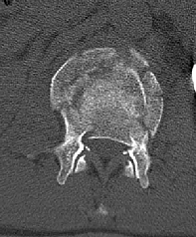
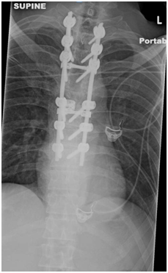
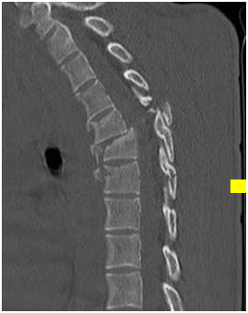
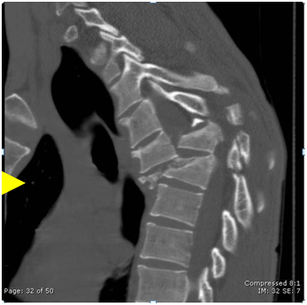
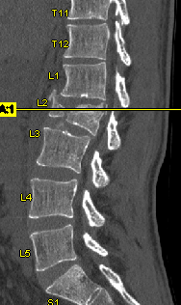
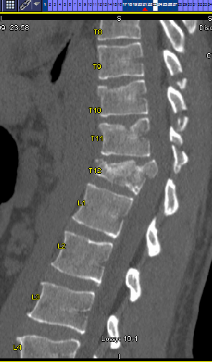
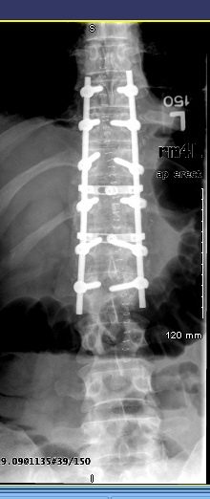
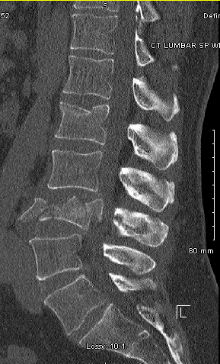
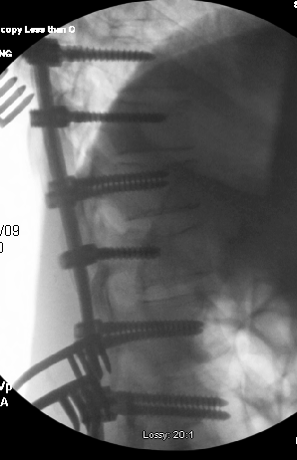
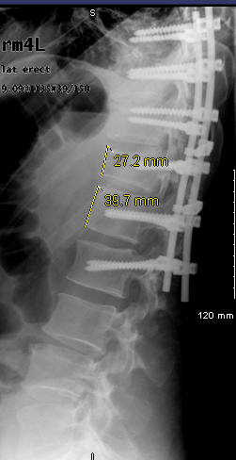
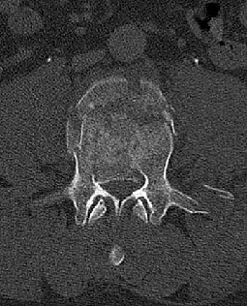
Trauma

Slide 20
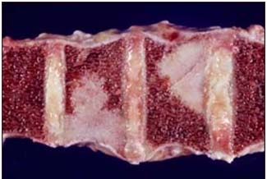
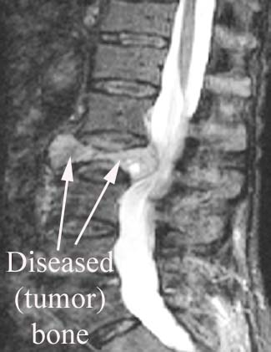
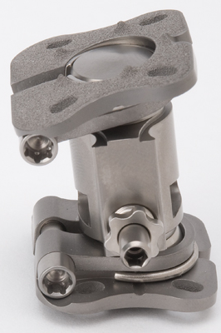
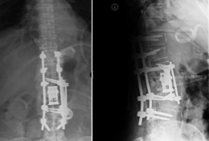
Tumor
Must remove all of the diseased bone, replace with a Vertebral Body Replacement
Requires stabilization across the completely disconnected segment

Slide 21
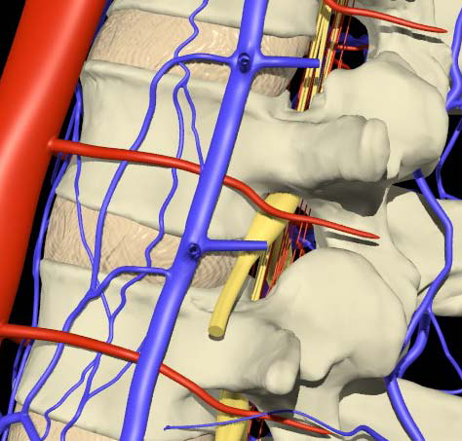
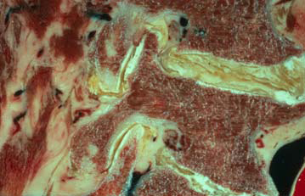
Foraminal Stenosis
Limited to neurological deficit only at affected levels
Stenosis (narrowing of a hole)
Foramen (hole for peripheral nerves)

Slide 22
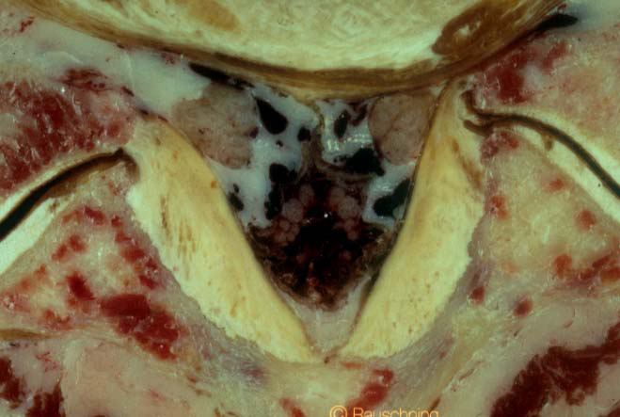
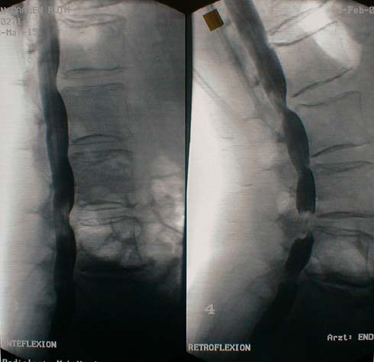
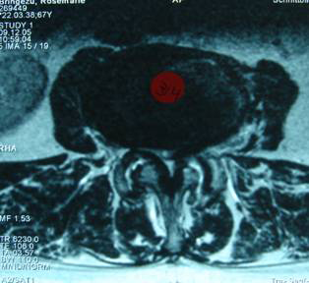
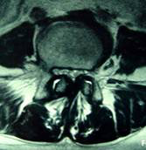
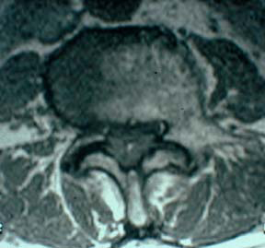
Spinal Canal Stenosis
Causes
Hypertrophy of the Ligamentum Flavum
Arthrotic hypertopy of the facet joints
Disc protrusion/herniation
Low back pain radiating into the leg
Paraesthesia, weakness, numbness
Improvement when sitting

Slide 23
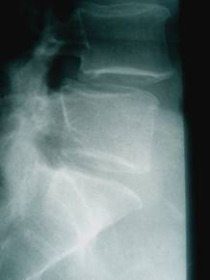
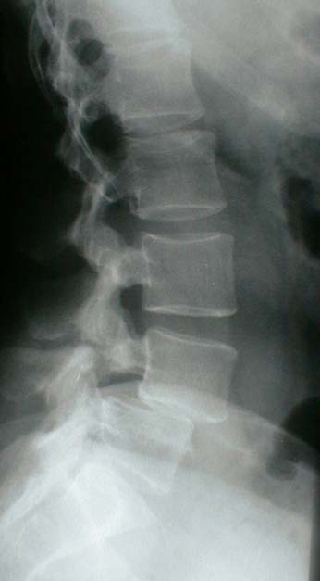

Spondylolisthesis
Anterior subluxation (movement) of one vertebral body compared to another
Symptoms
Lower back pain
non-radicular leg pain
worsens wehen standing

Slide 24



Scoliosis
assymetrical tilt of lumbar vertebrae
rotation of motion segments
loss of lumbar or segmental lordosis

Slide 25



Failed Backsurgery Syndrome
As obvious as it sounds
Many causes
Implant misplacement
Surgeon doesn’t understand biomechanics
Implant failure
Implant migration
Psuedoarthrosis (Lack of fusion)

Slide 26

Motion Segment
6 degrees of freedom
Total movement is limited by intact:
Annulus
Sharpey’s Fibers
ALL
PLL
3 Joint Complex
Ligamentous structures
Muscles

Slide 27

Anterior/Posterior weight balance

Slide 28


What motion actually occurs?

Slide 29








Spine Biomechanics and Kinesiology

Slide 30

Cervical Spine
Motion
Occipitoatlantoaxial complex
specialized articulation
large ROM
60% axial rotation
C3-C7
High flexibility in Flexion/Extension and Lateral bending
Axial Forces
<100N
Torsional Forces
<2 to 3 Nm

Slide 31

Thoracic Spine
Motion
Flex-ex – upper: 4º, middle: 6º, lower: 12º
Lateral bending – upper: 6º, lower 2/3: 9º
Axial rotation – upper 1/2: 8º, lower 3 segments: 2º each
Axial Forces
<1000N
Torsional Forces
<7 to 8 Nm

Slide 32

Lumbar Spine
Motion
Flexion-Extension ranges from 4 to 16 degrees
Lateral bending ~6°
Very little axial rotation
Axial Forces
<3000N
Torsional Forces
<10 to 15 Nm

Slide 33

Overview of Motion

Slide 34



The Complicated Biomechanics of the Natural Disc
The disc, ligaments, and facet anatomy all directly impact the biomechanics of the natural disc
IAR or COR : an easy way for us to think about motion.
Motion is really a combination of linked moments (rotation) and translation.

Slide 35

The Complicated Biomechanics of the Natural Disc
Thankfully, this has been studied
Unfortunately, the conclusions have been conflicting
It’s very difficult to measure.

Slide 36
Surgical Technique
Anterior Approach and implantation technique

Slide 37

Muscular structures
Psoas major
muscle
L 2
Quadratus
lumborum
muscle
Erector spinae
muscle
illiocostalis
longissimus
spinalis
Thoracolumbar fascia
posterior layer
anterior layer
Notes:
37

Slide 38

Approach options
Anterior transperitoneal
Anterior retroperitoneal
Antero-lateral retroperitoneal
Antero-lateral transmucular

Slide 39

Approach options
Anatomical structures, which must be respected

Slide 40
Surgical Technique

Slide 41



Define / Midline Marking - Anterior Approach
Instrument with detachable tip, which helps to define the AP center line of the disc space.

Slide 42

Discectomy and Endplate Preparation
A choice of instruments is available in the discectomy set :
4 Rongeurs 1 Kerrison 3 Scoops 2 Curettes 1 Raspatory 1 Nerve exploration hook

Slide 43


Discectomy and Endplate Preparation
In order to maintain the distraction height,
discectomy spacers in 4 heights can be used.

Slide 44


Release / Initial Distraction
Distraction forceps with angled handle

Slide 45


Parallel Distraction / Height Measurement
New instrument with several functions:
Size verification
Height measurement

Slide 46




Parallel Distraction / Height Measurement
New instrument with several functions:
Parallel distraction
For midline and anterior-lateral approach

Slide 47

Implantation
En bloc implantation avoids overdistraction.

Slide 48

Implantation
Integrated spacer guarantees correct angle of prosthesis during insertion.

Slide 49

activ L Implanted

Slide 50
Introducing activL® Artificial Disc Intelligent Motion Technology™ Katie Kleinschuster, activL Product Manager

Slide 51

It’s the first new lumbar disc FDA approved in almost ten years
1

Slide 52
2006 ProDisc-L is FDA Approved
2015 activL® Artificial Disc is FDA Approved
Innovation

Slide 53

Only we can offer the next generation in Motion Preservation
2

Slide 54

Next generation TDR technology more closely mirrors the natural biomechanics of the healthy human spine
Due to its AP translating core design, activL® Artificial Disc allows the superior vertebra to remain in a more natural position during flexion and extension. This serves to minimize excessive load on the facet joints.
Notes:
Speaker’s notes to be completed

Slide 55

Intelligent Motion Technology™ combines natural motion with mechanical stability allowing clinically-stable translational and rotational movement
Our Motion Preservation
Their Motion Preservation

Slide 56

Only we have the best anatomical match to diverse patient needs
3

Slide 57


activL® Artificial Disc offers the widest range of endplate configurations and construct heights to meet diverse anatomical needs
Our Implant
Their Implant

Slide 58

Only we can offer peace of mind from anterior dislocation of the inlay
Insert assembly image from x:drive
4

Slide 59



The activL® Artificial Disc PE inlay lies inside the inferior plate. In this position the inlay is protected from dislocation.
Our Implant
Their Implant
Yikes! The click and pray method?!

Slide 60

Only we can offer single-step insertion
5

Slide 61








Simple all-in-one insertion prevents over-distraction and saves procedural time
Our Insertion Method
Their Insertion Method

Slide 62

Independent reviewers agree activL® Artificial Disc is clearly clinically differentiated
6

Slide 63

The high impact factor, Spine Journal has published the activL® Artificial Disc IDE Outcomes
p<0.001
PUBLISHED & OPEN ACCESS
Garcia et al. Spine. 2015.

